Slide 1

2. Preprocessing
Jose Alejandro Romero Herrera
Data Scientist

Slide 2
Agenda
File formats
Cutadapt/Trim Galore
Trimming and filtering
Read alignment
Quality control
STAR/Bowtie2/Salmon/Kallisto
FastQC/MultiQC
START/Salmon/Kallisto/FeatureCounts
Read count tables

Slide 3
Agenda. Preprocessing
File formats
Cutadapt/Trim Galore
Trimming and filtering
Read alignment
Quality control
STARSolo
CellRanger
Demultiplexing
FastQC/MultiQC
Read count tables

Slide 4
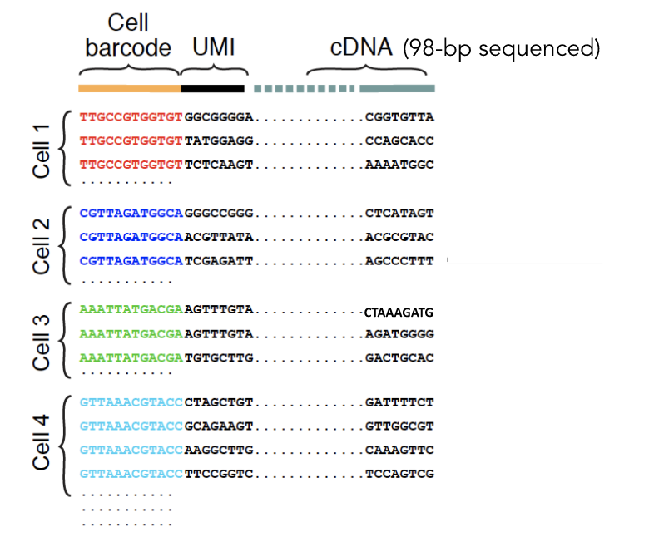
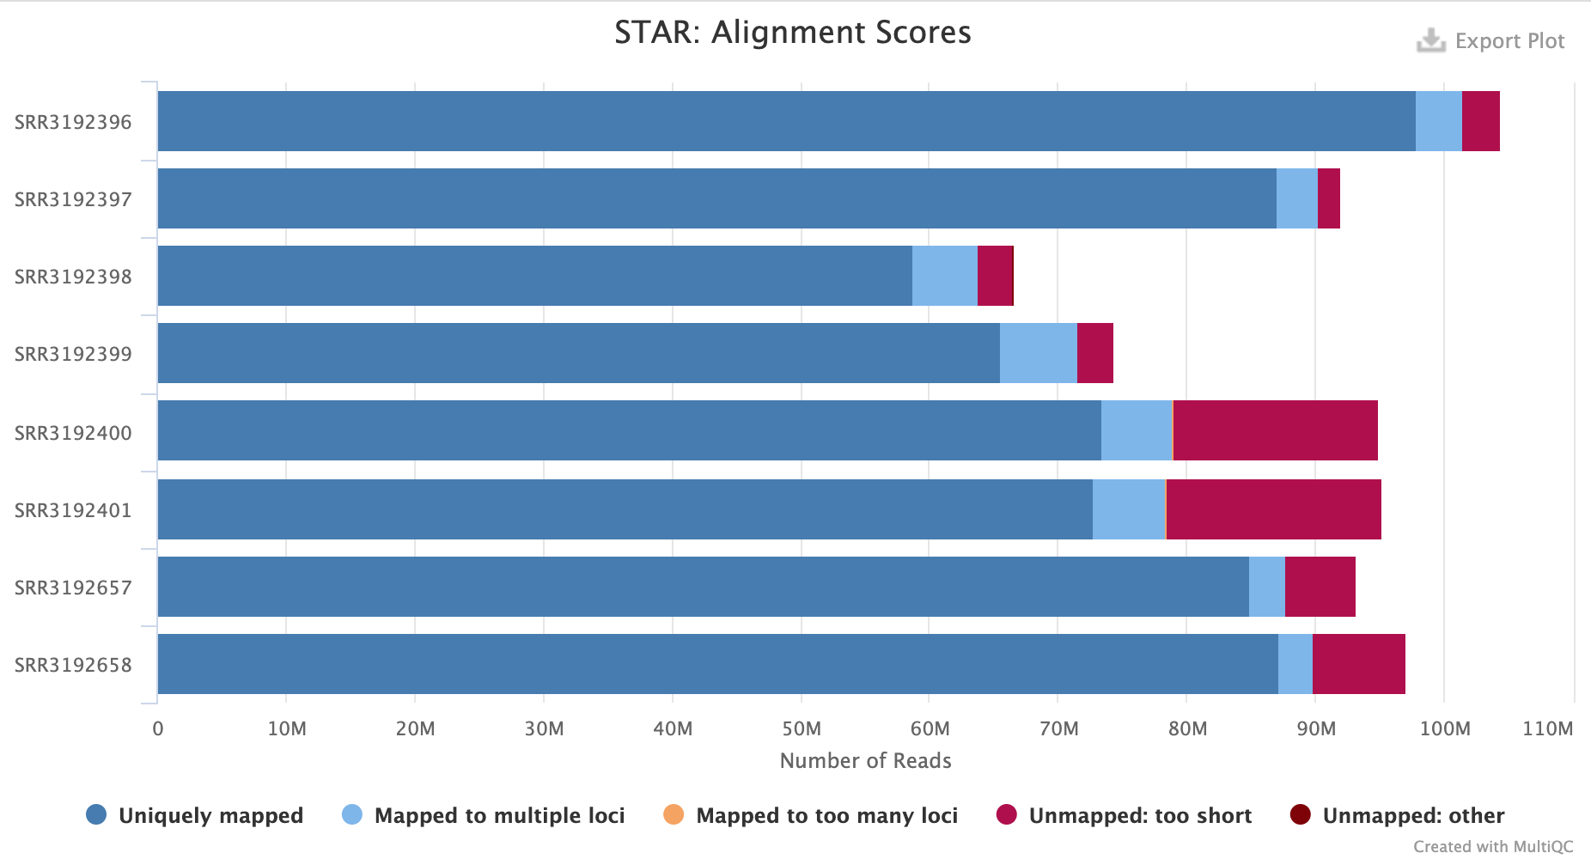
Workflow
Reference genome
fasta file
Sequencer
“raw” reads
Extract cell barcode/UMI
Cleaned and trimmed reads
Aligned reads
Cell-barcode
UMI
Transcript
fastq file
fastq file
SAM file
Demultiplexing/Deduplication
Read count table
Quality control check
Genes | Cell 1 | Cell 2
A | 5 | 1
B | 3 | 100
C | 9 | 34
MultiQC report

Slide 5
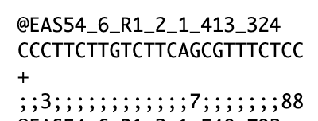
Fastq. Raw read file format
Read information out of the sequencer
Contains
ID of the read. ID and description depends on technology
Sequence
Quality of each nucleotide (Phred score/quality)
We can use Phred score to filter low quality reads
CutAdapt
Trim Galore!
Notes:
Phred Score: http://maq.sourceforge.net/qual.shtml
TrimGalore: https://www.bioinformatics.babraham.ac.uk/projects/trim_galore/

Slide 6
Fastq. 10x reads
10x Barcode is a Cell Identifier for a sample
UMI (Unique Molecular Identifier) to label original cDNA molecules (PCR duplicates)
Sample Index tags cell samples so different samples can be analysed together
Notes:
Phred Score: http://maq.sourceforge.net/qual.shtml
TrimGalore: https://www.bioinformatics.babraham.ac.uk/projects/trim_galore/

Slide 7
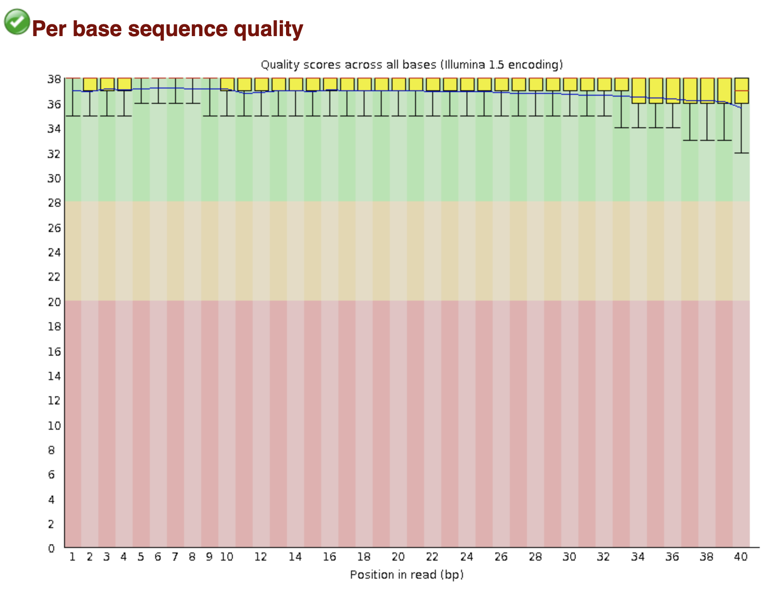
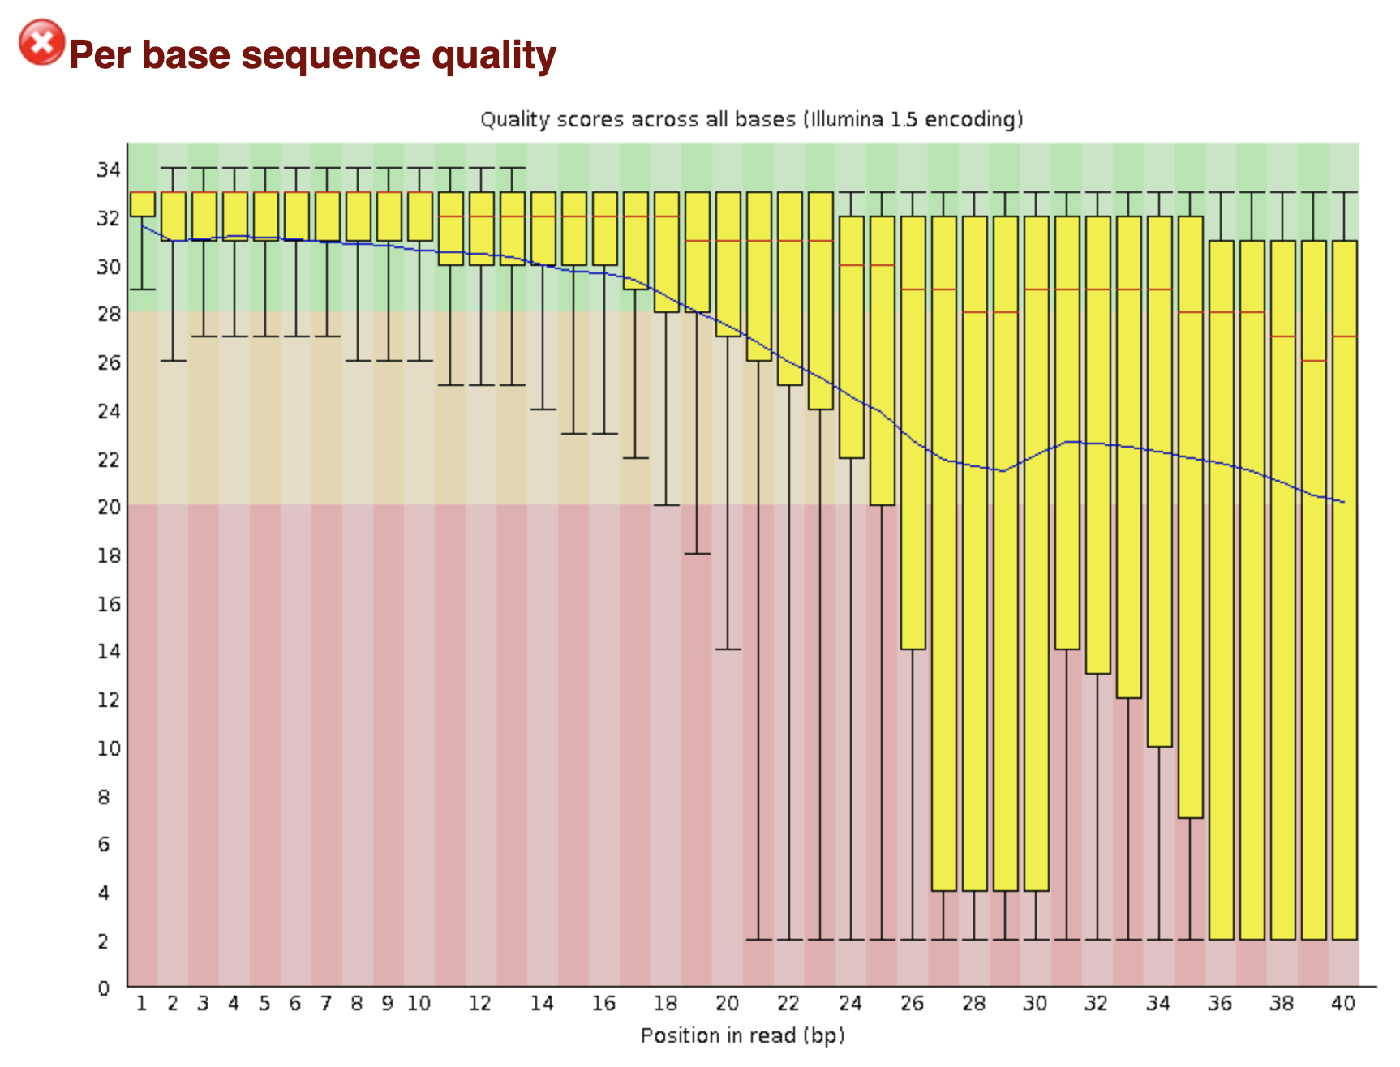
Quality Control. FastQC
Simple way to do some QC checks on raw sequence data
Basic statistics, sequence quality and GC content, duplications, etc
Notes:
fastQC: https://www.bioinformatics.babraham.ac.uk/projects/fastqc/
FastQC checks:
Basic Statistics
Per base sequence quality
Per tile sequence quality
Per sequence quality scores
Per base sequence content
Per sequence GC content
Per base N content
Sequence Length Distribution
Sequence Duplication Levels
Overrepresented sequences
Adapter Content

Slide 8
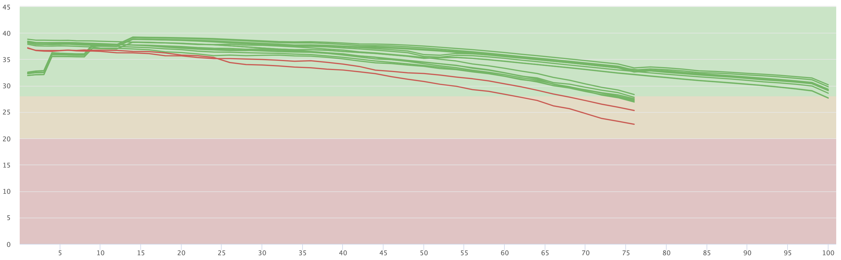
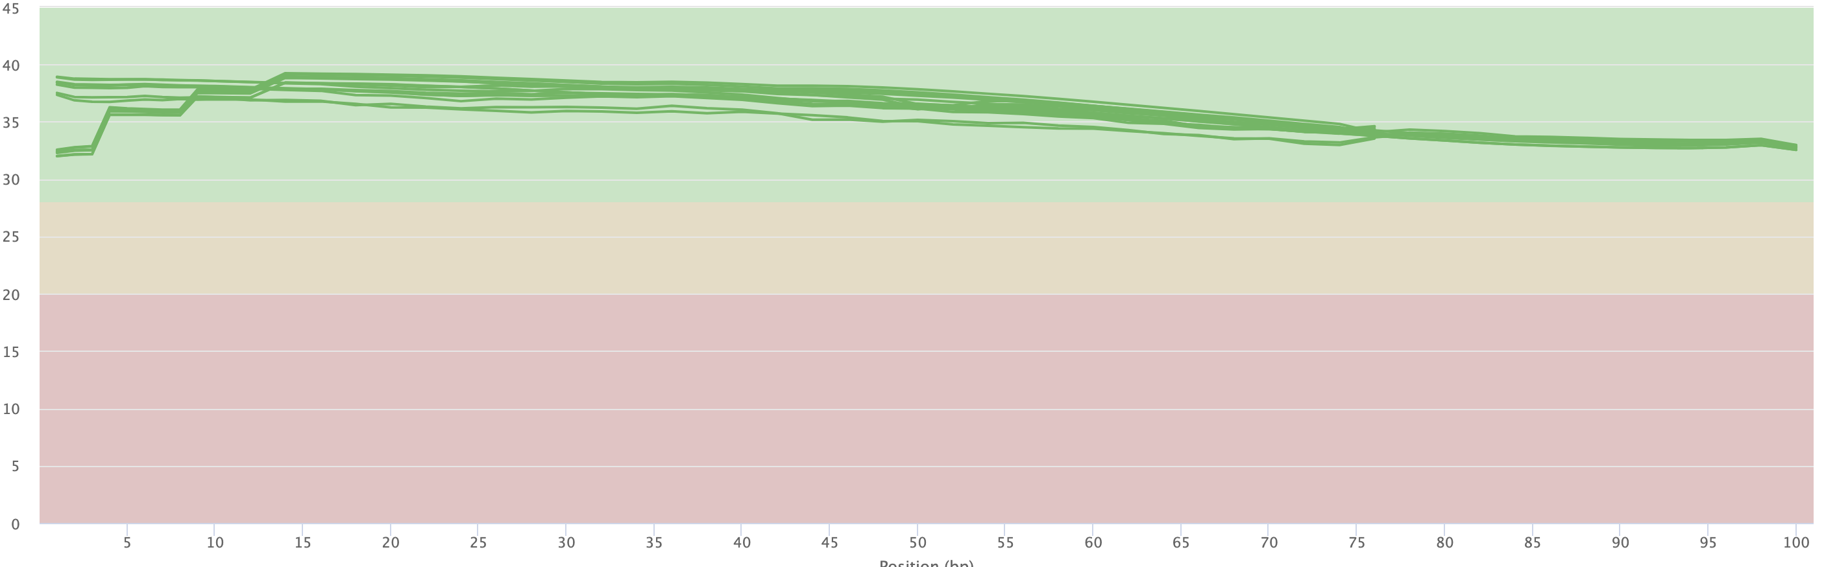
Trimming and filtering
Tools
CutAdapt
TrimGalore
Trimmomatic
Can help to clean your raw sequencing data
Remove adapters, poor reads and poly-A tails, trim poor bases
We do not need to worry about duplicates, unless it is really excessive
Mean Quality scores (raw)
Mean Quality scores (trimmed and cleaned)
Phred score

Slide 9
Read Alignment. Traditional mapping
Align to reference genome – RNAseq
Before it was normal to map to the exome
We are interested in genes or annotated regions → GTF/GFF3
Always try to align to the newest version of your reference!
Tools:
STARsolo
CellRanger
Reference
genome
ATAC/ChIP-seq
reads
250 bp
300 bp
350 bp
400 bp
RNAseq
reads
Enhancer?
Genes (Exome)
A
B
Notes:
STAR: https://hbctraining.github.io/Intro-to-rnaseq-hpc-O2/lessons/03_alignment.html
Bowtie: http://bowtie-bio.sourceforge.net/index.shtml
BWA: http://bio-bwa.sourceforge.net/

Slide 10
Fasta format
>mm10_chr1| Chromosome 1 of Mouse genome version 10
CACACACTTTTCTCACACTATTAGGTAACCCTCTGCCTTATTCCACACTTCCTCCATGAT
GTGCTCCCCGTAGTCACAAAGCCAGCTGGAGACAGACTAGAGCAATGAGCCAAAAGTAGA
CCTTTCCTCCTTTTAACTTGACTGTCTTGAATATTCTGGTACAGTAACAGAAATCTGACT
AGCAGGTCCTTGAGTGAATTCCACCTACATGTGGATATGTGTGAGGATAGAGACCTGTTC
Aminoacid or nucleotide sequence
Starts with a single line description ”>”,
Reference IDs or descriptions of the sequence, separated by “|”
Usually used for reference genomes or exomes
Notes:
Human or mouse https://www.gencodegenes.org/

Slide 11
Demultiplexing
Use retrieved cell barcodes and sample indexes
Barcodes are ”whitelisted”
Reads are sorted to their cells and samples
Small errors in sequencing of cell barcodes and UMIs can be fixed

Slide 12
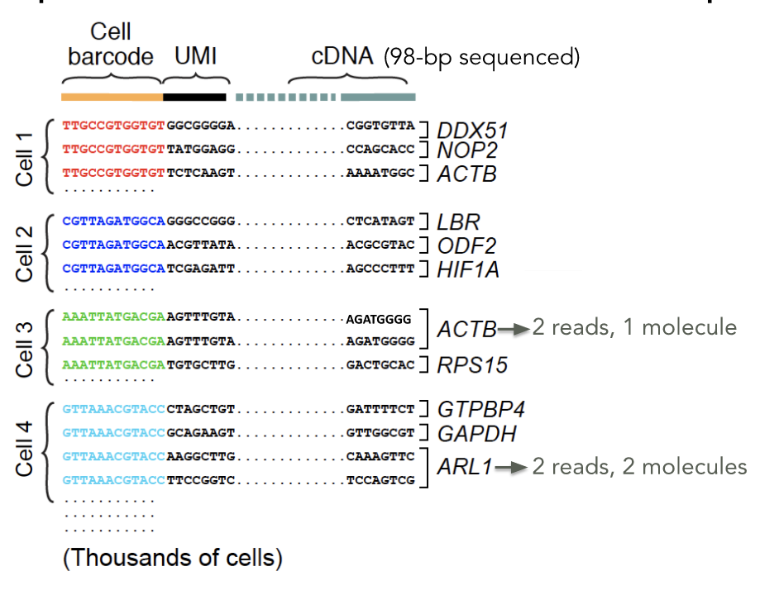
Deduplication
Transcripts might be overrepresented
Due to extra PCR amplification cycles
UMIs are used to deduplicate and remove noise

Slide 13
Read count tables
Tools:
STARsolo/CellRanger
Matrix of read counts per gene or per genomic region
bam file reads
Reference
sequence
100 bp
150 bp
200 bp
250 bp
300 bp
350 bp
400 bp
Gene/Transcript | Counts
A | 5
B | 3
C | 9
A
B
C
Genes/Transcripts (GTF/GFF)
Notes:
Bedtools: https://bedtools.readthedocs.io/en/latest/
STAR aligner: https://hbctraining.github.io/Intro-to-rnaseq-hpc-O2/lessons/03_alignment.html
Star aligner can do read count tables with the “--quantMode GeneCounts” option
Rsubread: https://bioconductor.org/packages/release/bioc/html/Rsubread.html

Slide 14
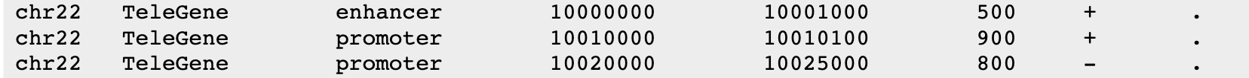
GFF/GTF formats
General Feature Format (GFF3). Tab separated file
Contains genomic features: promoter, enhancer, exon, gene, etc.
Column 9 contains attributes: gene id, gene name, transcript id, etc.
Gene Transfer Format (GTF). Pretty much the same
seqid
feature
end
strand
source
start
score
frame
ID=ENSMUSG00000102693.2;gene_id=ENSMUSG00000102693.2;gene_type=TEC;gene_name=4933401J01Rik;
level=2;mgi_id=MGI:1918292;havana_gene=OTTMUSG00000049935.1
gene_id "ENSMUSG00000102693.2"; gene_type "TEC"; gene_name "4933401J01Rik";
level 2; mgi_id "MGI:1918292"; havana_gene "OTTMUSG00000049935.1"
Notes:
GFF3: https://www.ncbi.nlm.nih.gov/datasets/docs/v1/reference-docs/file-formats/about-ncbi-gff3/
seqname - The name of the sequence. Must be a chromosome or scaffold.
source - The program that generated this feature.
feature - The name of this type of feature. Some examples of standard feature types are "CDS" "start_codon" "stop_codon" and "exon"li>
start - The starting position of the feature in the sequence. The first base is numbered 1.
end - The ending position of the feature (inclusive).
score - Currently only provided for alignments, if they contain a score named “score”. The definition of this score may vary depending on the type of alignment.
strand - Valid entries include "+", "-", or "." (for don't know/don't care).
phase - If the feature is a coding exon, frame should be a number between 0-2 that represents the reading frame of the first base. If the feature is not a coding exon, the value should be ".".
attributes - All lines with the same group are linked together into a single item.

Slide 15
Pseudomapping &
quantification
Alignment and quantification in one step
Super fast! 30M reads in <10 min
Easy to use! Download their data and calculate your count matrices
Precomputed indexes for several species:
Human
Mouse
Tools:
Salmon
Kallisto
Kallisto pseudomapping
Notes:
The input consists of a reference transcriptome and reads from an RNA-seq experiment.
An example of a read (in black) and three overlapping transcripts with exonic regions as shown.
An index is constructed by creating the transcriptome de Bruijn Graph (T-DBG) where nodes (v₁, v₂, v₃, ... ) are k-mers, each transcript corresponds to a colored path as shown and the path cover of the transcriptome induces a k-compatibility class for each k-mer.
Conceptually, the k-mers of a read are hashed (black nodes) to find the k-compatibility class of a read.
Skipping (black dashed lines) uses the information stored in the T-DBG to skip k-mers that are redundant because they have the same k-compatibility class. (e) The k-compatibility class of the read is determined by taking the intersection of the k-compatibility classes of its constituent k-mers.

Slide 16
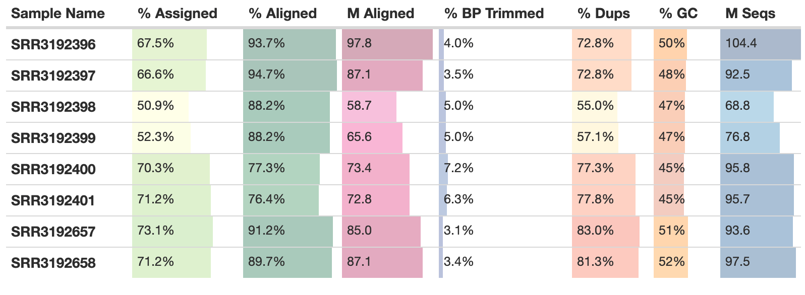
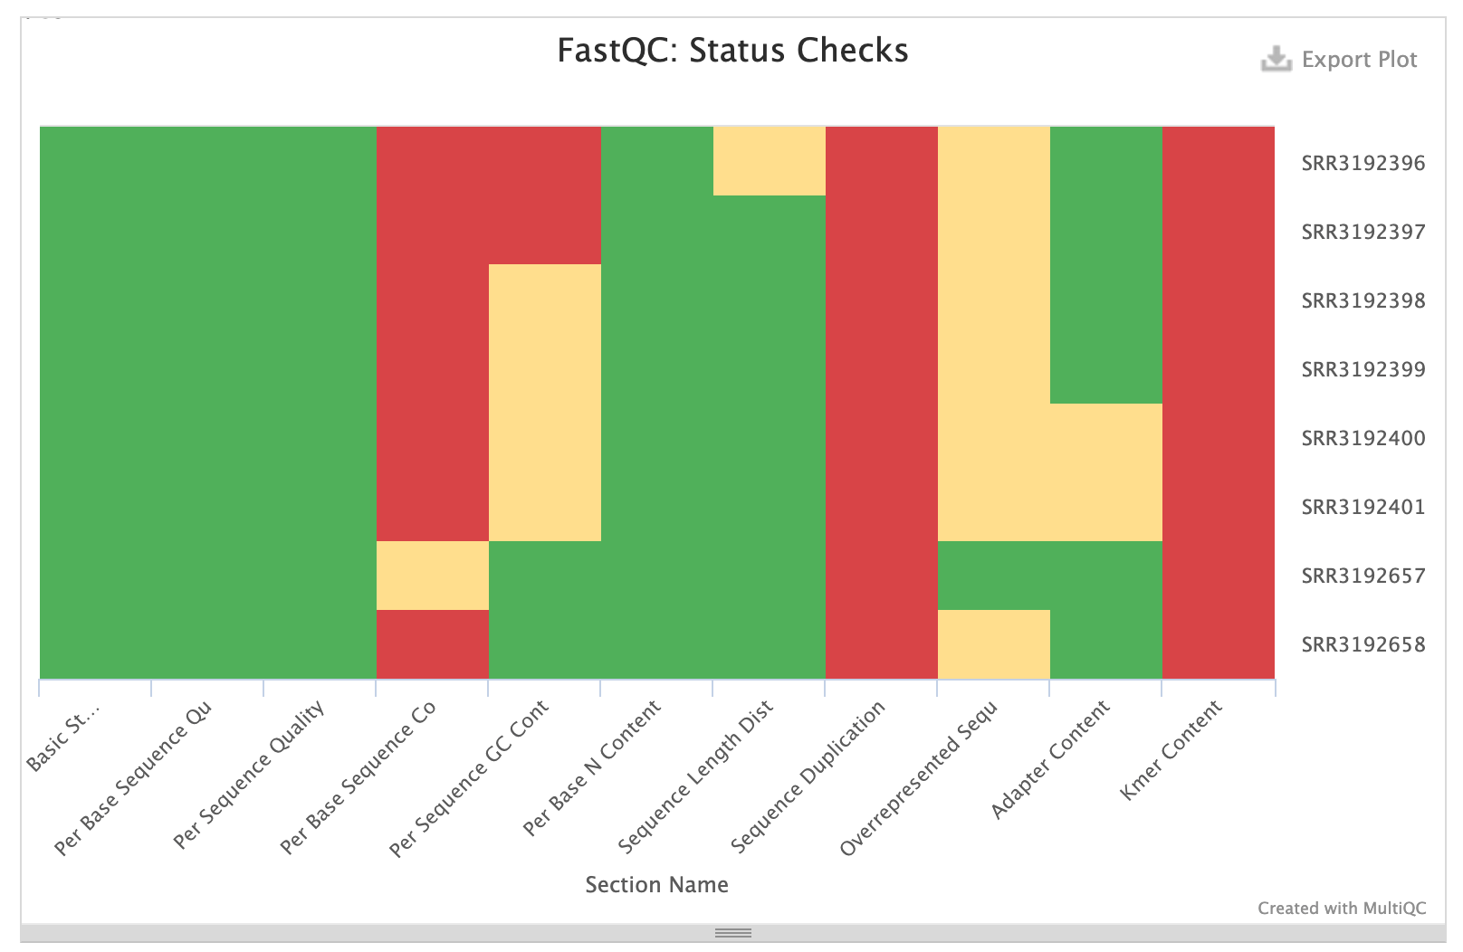
MultiQC reports
Summarises all kinds of reports:
FastQC
Trimming
Alignment
Feature counts
Even DEA
Notes:
MultiQC: https://multiqc.info/

Slide 17
Workflow
Reference genome
fasta file
Sequencer
“raw” reads
Extract cell barcode/UMI
Cleaned and trimmed reads
Aligned reads
Cell-barcode
UMI
Transcript
fastq file
fastq file
SAM file
Demultiplexing/Deduplication
Read count table
Quality control check
Genes | Cell 1 | Cell 2
A | 5 | 1
B | 3 | 100
C | 9 | 34
MultiQC report

Slide 18
pipelines
Summarised Workflow
Bioinformatics community for curated pipelines
Completely reproducible, following gold standards and easy to implement
More and more pipelines are being introduced and updated
Bulk RNAseq
Single Cell RNAseq
ATACseq
ChIPseq
HICseq
https://nf-co.re/pipelines
Notes:
https://nf-co.re/pipelines

